Slide 1
Buried Treasure
Transforming Pirates Alley into the Crown Jewel of North Bay Village
Prepared for:
Monday, July 15, 2024

Slide 2
Table of Contents
01
Overview of Approach
06
Summary of Recommendations
02
Village Meeting
07
Short Term Improvements
03
Stakeholder Meetings
08
Long Term Improvements
04
Consultant Meetings
09
Potential Challenges
05
Inspiration

Slide 3
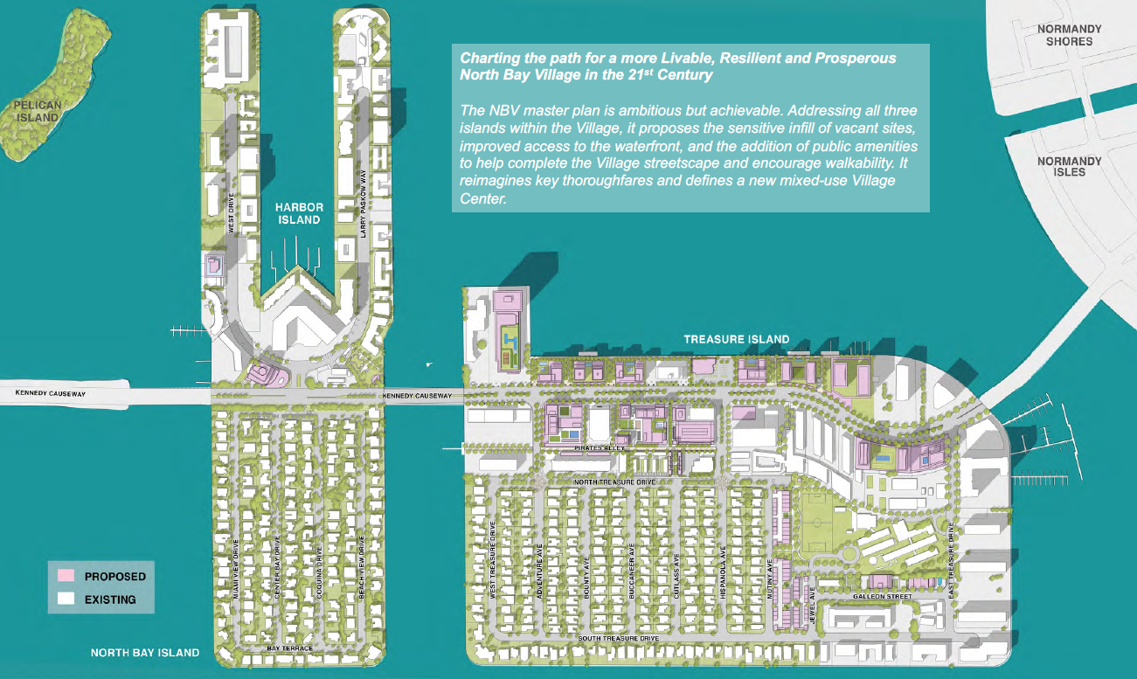
NBV100 Master Plan

Slide 4
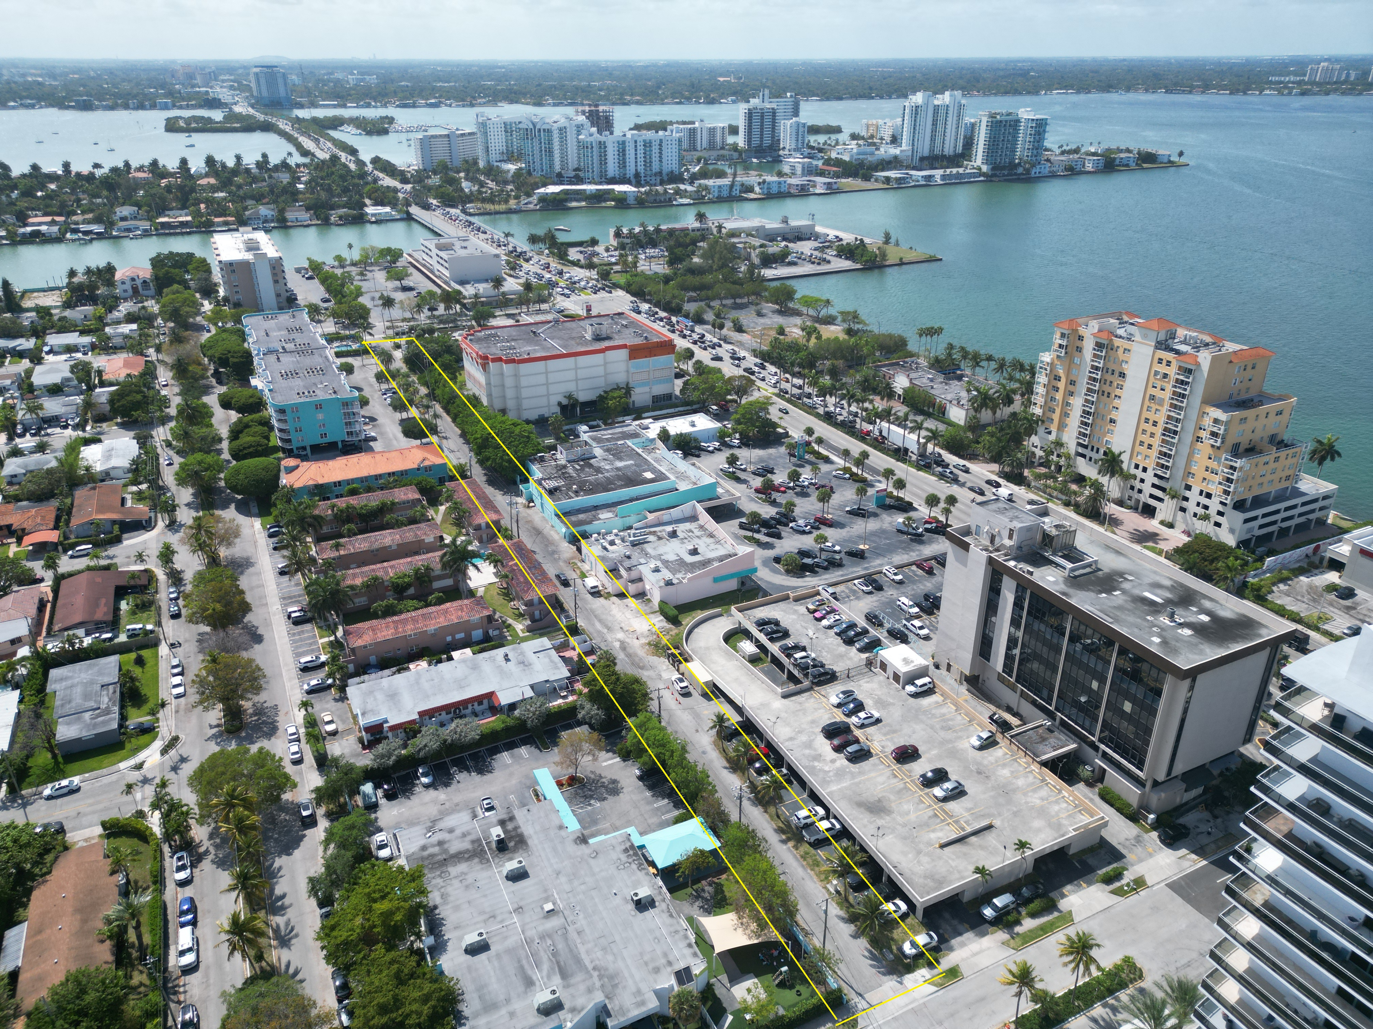
4
Overview of Approach
Background
Engage The Village
Meet Stakeholders
Consult
Recommendations

Slide 5
Village Meeting Recap
On February 15, 2024, the Team met with the following key people from North Bay Village:
Rachel Streitfeld – Commissioner
Dr. Ralph Rosado – Village Manager
Leonardo Cosio – Chief of Staff
Christian Molina – Legislative Aide
Pirates Alley is currently used by pedestrians but the user experience is very suboptimal. Most of the activity we observed was that of vehicular access, often at quite fast speeds.
The City is supportive of restricting commercial trucks using Pirates Alley for deliveries/pick-ups to only certain hours of the day to reduce congestion and allow more pedestrians to utilize the street.
Delivery hours
Walkability
Current Zoning Code (spurred by recommendations from the NBV100 Master Plan), requires that any redeveloped properties adjacent to Pirates Alley will have to implement store frontage that opens to Pirates Alley post-redevelopment.
The Village acknowledges that the existing condition of Pirates Alley is not ideal and requires a near-term/long-term solution.
Re-paving
Zoning Overlay

Slide 6
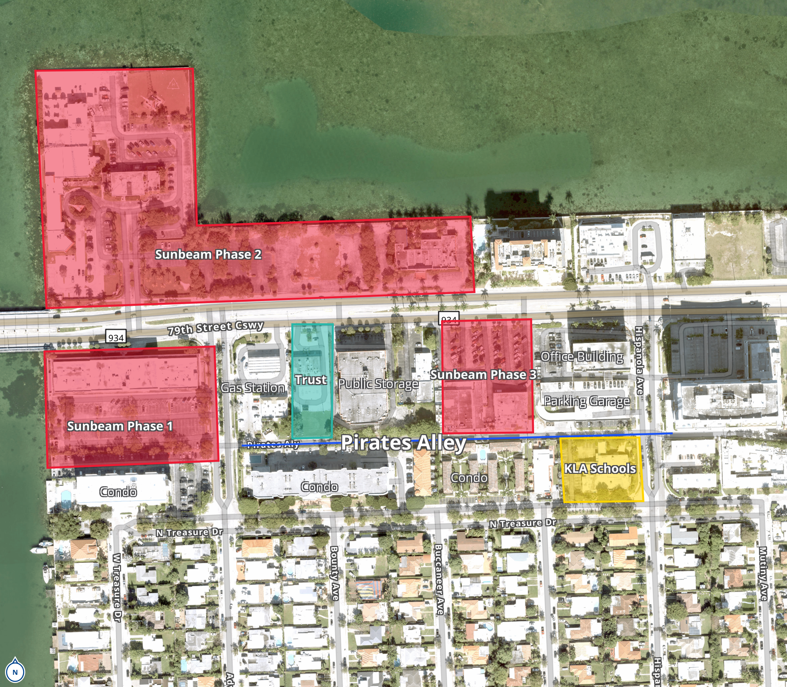
6
Stakeholder Map of Pirates Alley

Slide 7
Stakeholder Meeting Recaps
Stakeholder: James Bry (EVP of Development at Sunbeam Properties)
Key Takeaways:
Pirate’s Alley should be used for ingress/egress of commercial vehicles that will service their Phase I multifamily/retail project.
Supportive of restricting commercial vehicle usage to certain times of the day to allow the Alley to be primarily a pedestrian walkway
Skeptical that Pirates Alley can be transformed into a vibrant commercial district similar to Lincoln Road or Giralda Plaza given potential residential stakeholder opposition.
Stakeholder: Sophia Zamor Santa (KLA Schools of North Bay Village)​
Key Takeaways:
Shares enthusiasm for creating a more vibrant and safe environment for residents.
Has concerns about the possible negative impacts, primarily the traffic flow during pick-up and drop-off times.
Having access to the school via two different streets is critical for KLA to facilitate entry and exit for parents and their children. ​​
Ongoing
Unsuccessful
Stakeholder: North Bay Village Residents
Key Takeaways:
Survey posted in the North Bay Village Residents Speak Facebook group on Tuesday, June 25th, 2024 which has 4,000 members
The City of North Bay Village posted it and will analyze results to help implement recommendations
​
Stakeholder: 1500 79th Street Causeway Owner
Key Takeaways:
Hoped to discuss the possibility of converting the parcel into a public green space, such as a temporary dog park
​

Slide 8
Consultant Meeting Recaps
Consultant: Tony Garcia (Principal of Street Plans)
Key Takeaways:
Implement short-term, low-cost, scalable interventions to catalyze long-term change, transforming the Alley into a vibrant public space
Avoid overly prescriptive guidelines, instead require new developments to enhance the public space quality
The Village should work with developers to design buildings that improve walkability and connect public spaces
Consultant: Sylvia Beltre, Paola Davalos, and Ytve Guerrera (Ardurra Group)​
Key Takeaways:
Assessed pros and cons of maintaining vehicular access while implementing shared pedestrian paths
Elevated walkways can provide safe separation from vehicles and address drainage concerns but require comprehensive traffic analysis
Consider technical constraints and resiliency issues including the impact from adjacent residential buildings

Slide 9
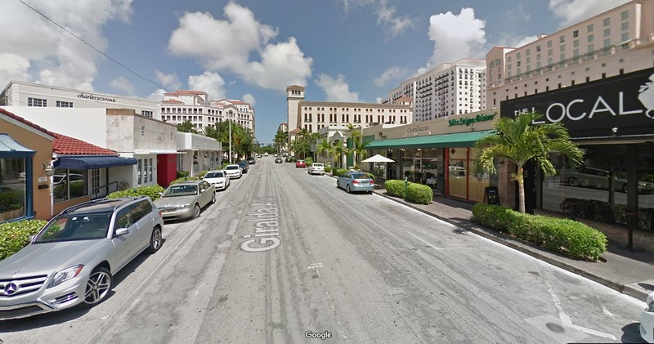
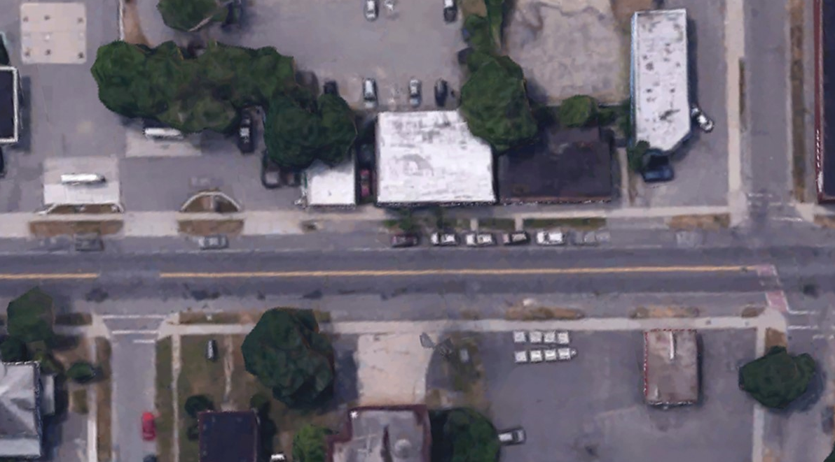
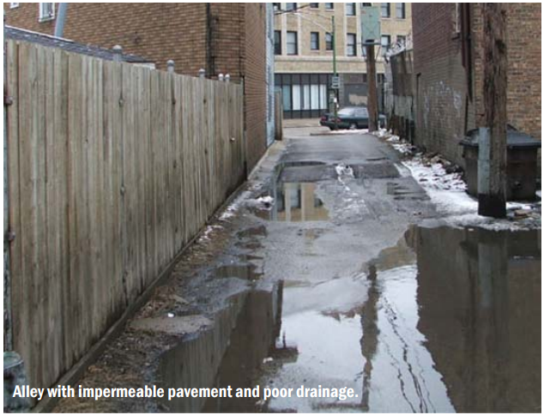
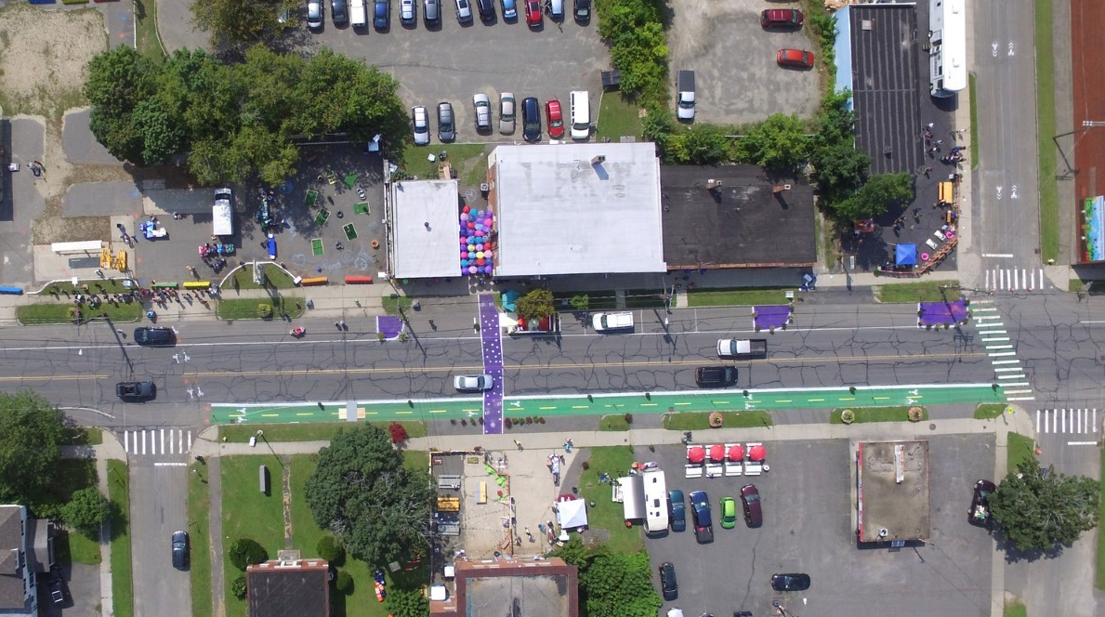
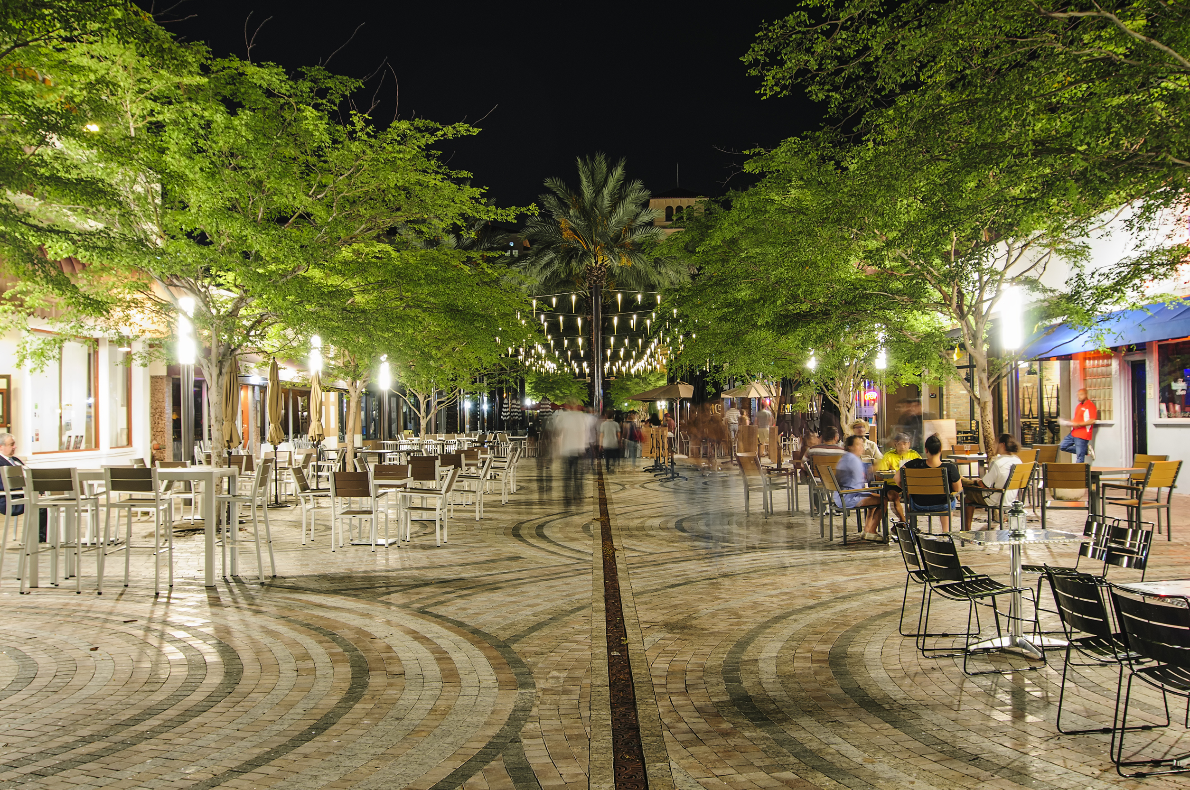
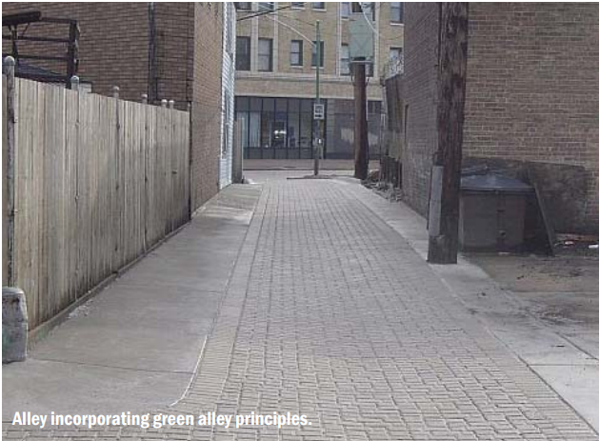
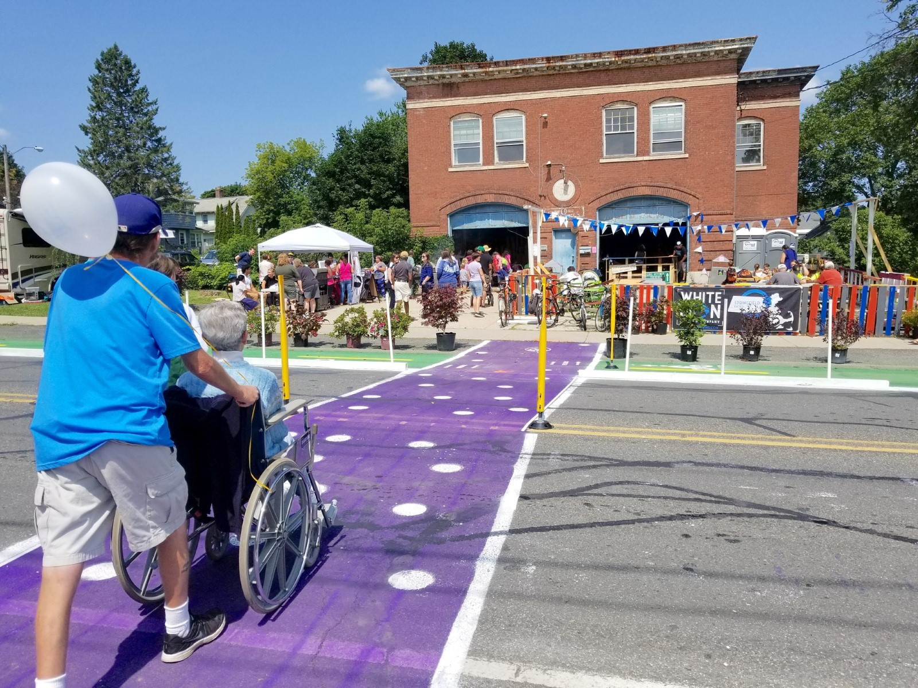
Inspiration
Local
National
National – Green Alley
Giralda Avenue, Coral Gables, Florida
Better Block, Pittsfield, Massachusetts
Chicago's Green Alley Program
Before
Before
After
After
Activation

Slide 10
Summary of Recommendations
Short Term Improvements
Beautification: Repaving, landscaping, canopies, upgraded dumpsters, and public art
Resilience: Green infrastructure
Activation: Temporary container coffee shop, temporary dog park, and resident requested activities
Long Term Improvements
Special Assessment District
Zoning Overlay
Public funds for ongoing improvements

Slide 11
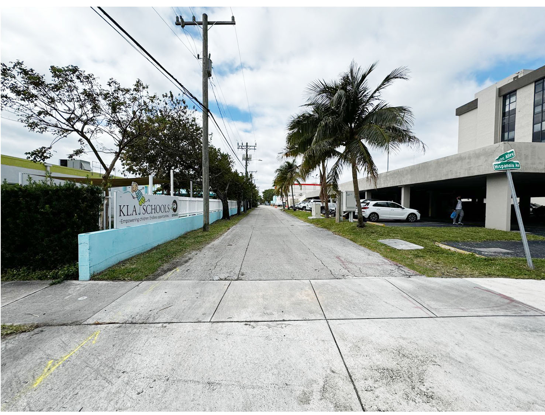
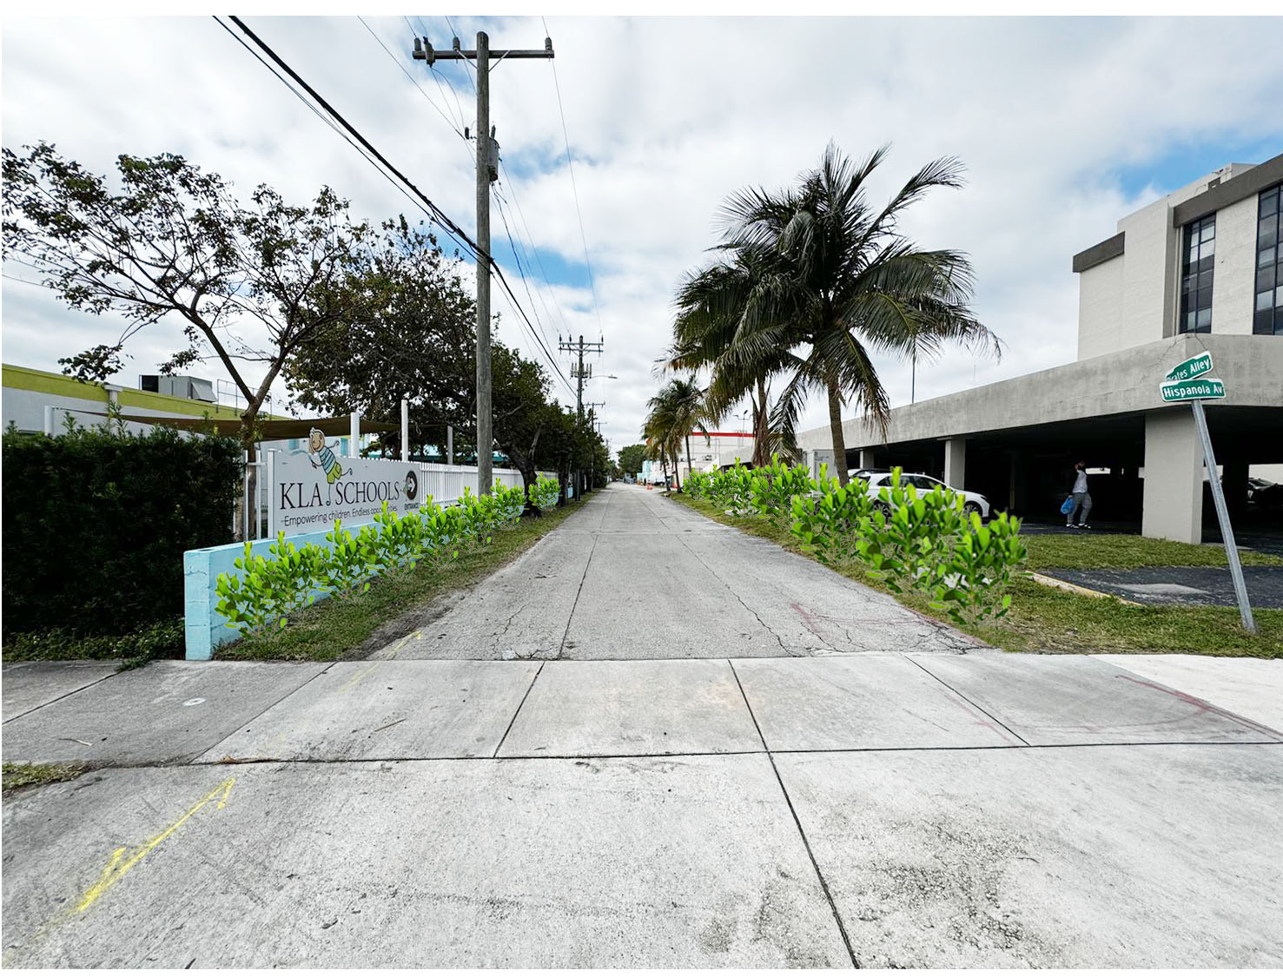
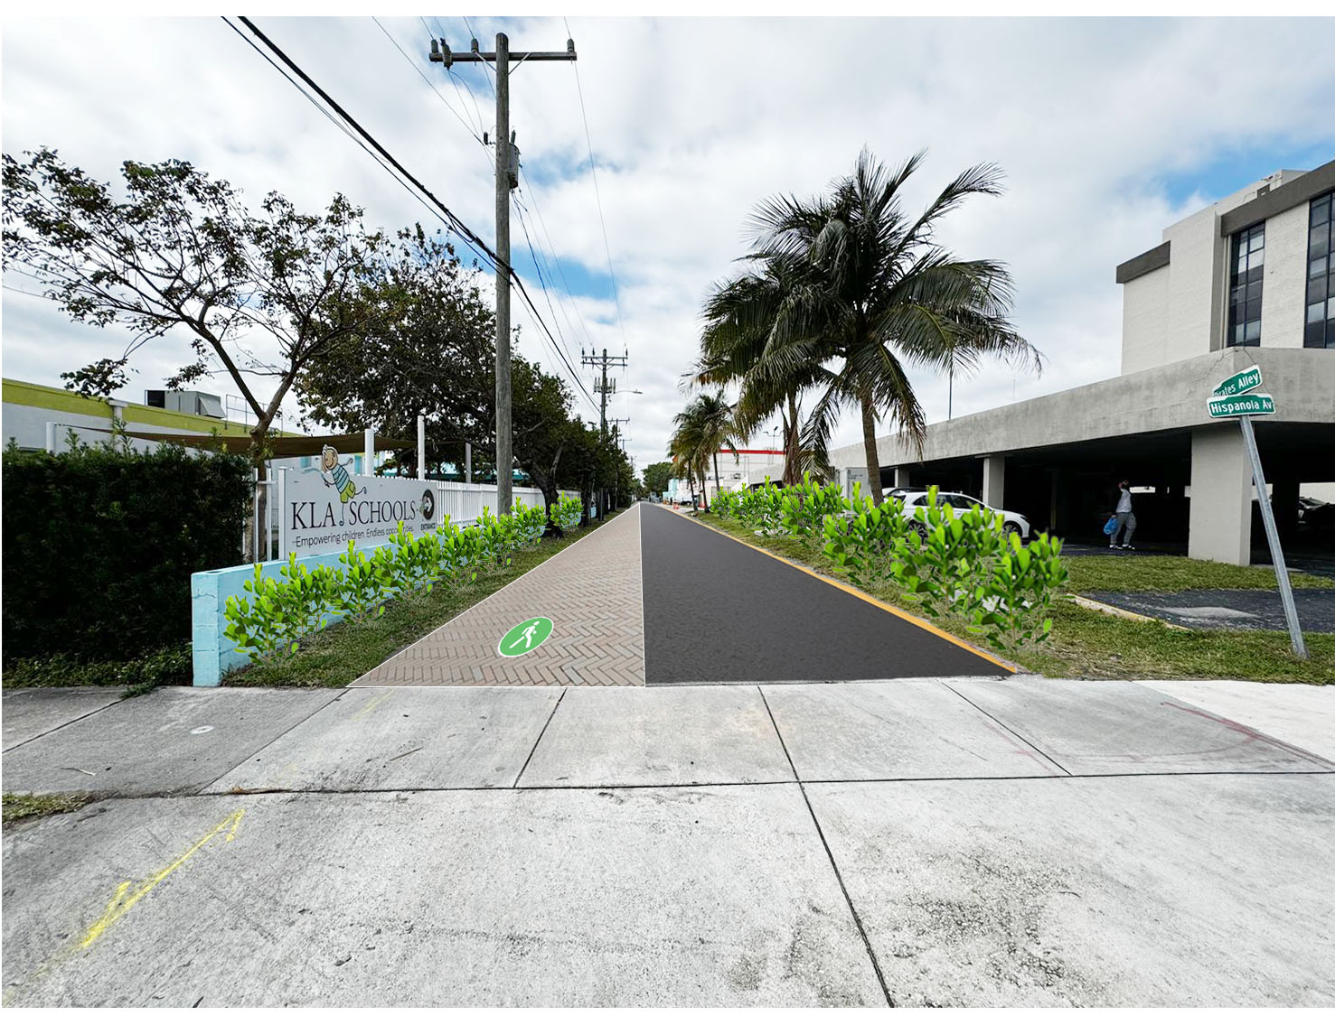
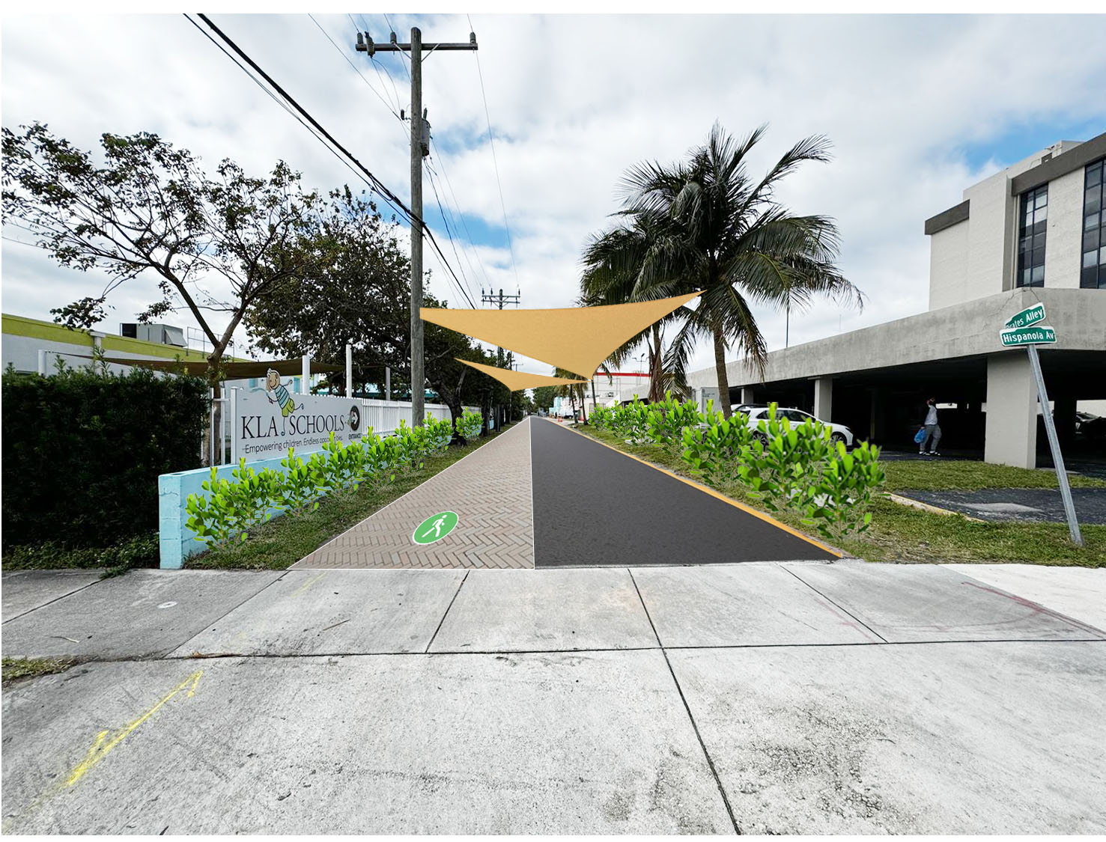
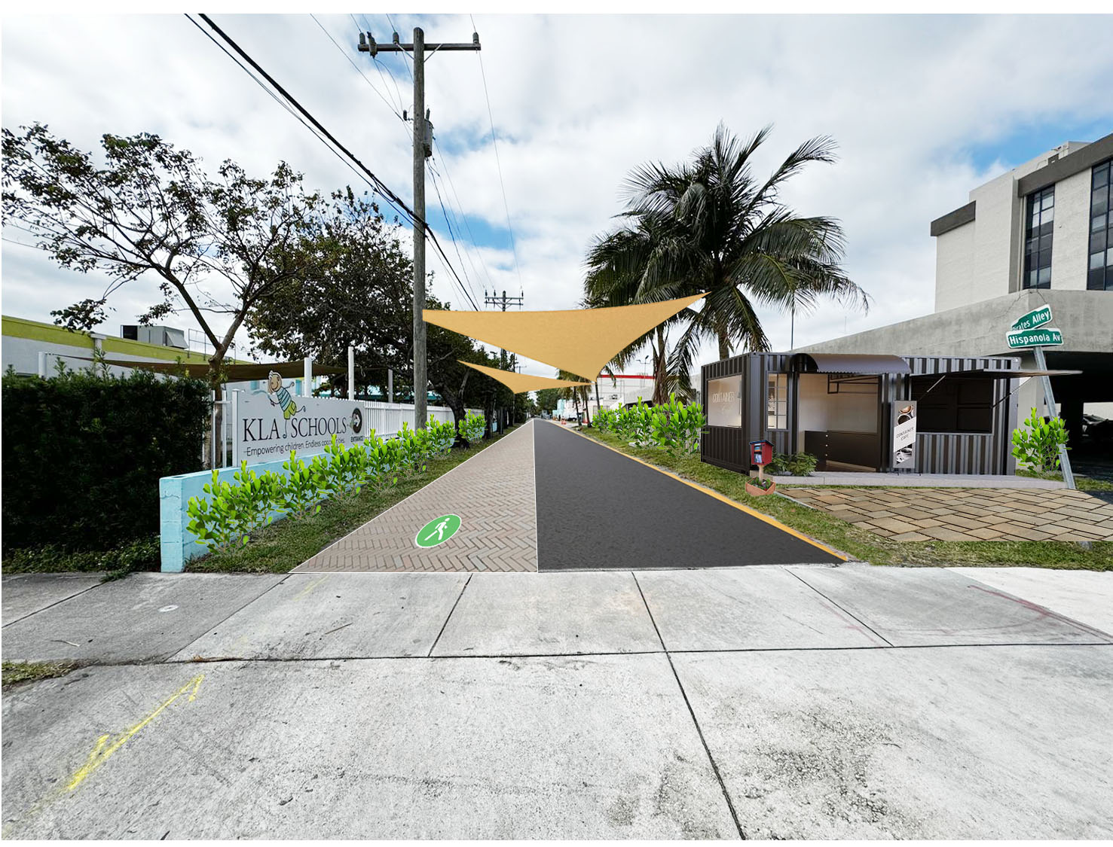
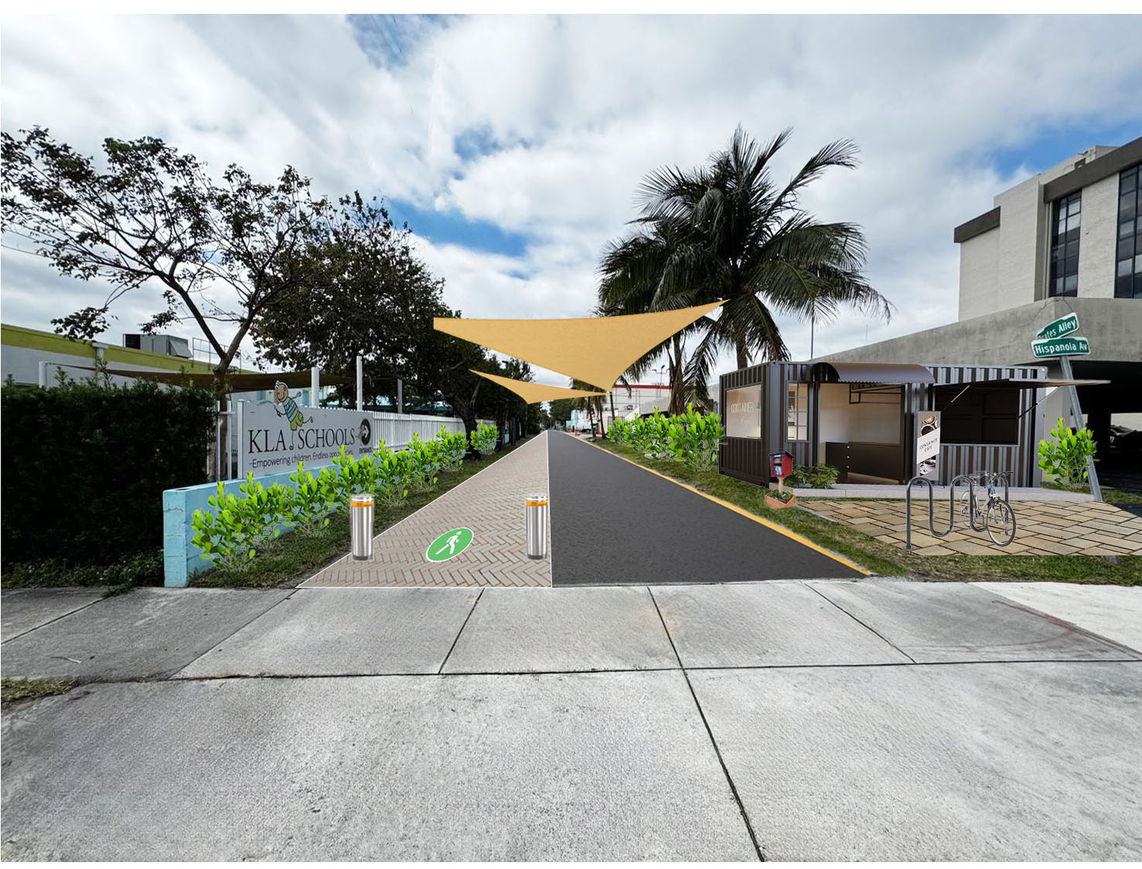
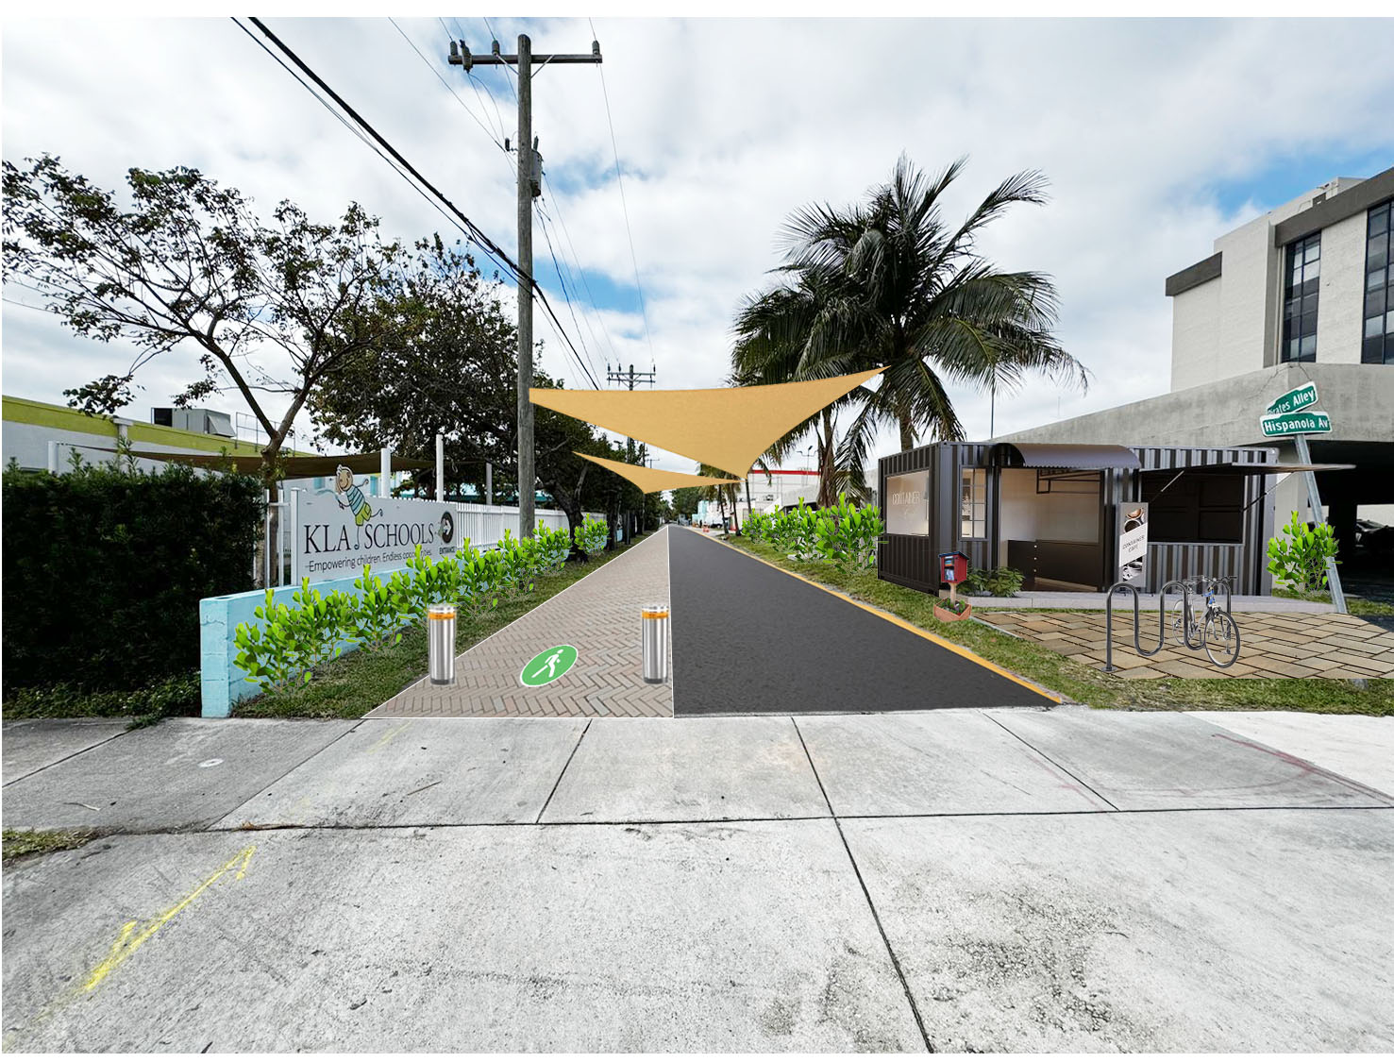
Short Term Improvements
Landscaping, Paving, and Pedestrianization Improvements
Improved landscaping to beautify the alleyway.
Repaving the two-lane alley way, which is already in the Village’s budget, would allow for the creation of one lane dedicated as pedestrian walkway.
Adding canopies to provide shade for pedestrians, providing relief from weather and hot days.
Activating the area with temporary uses
Adding pedestrian Safety features
Adding Bike Racks
Bury FPL lines

Slide 12
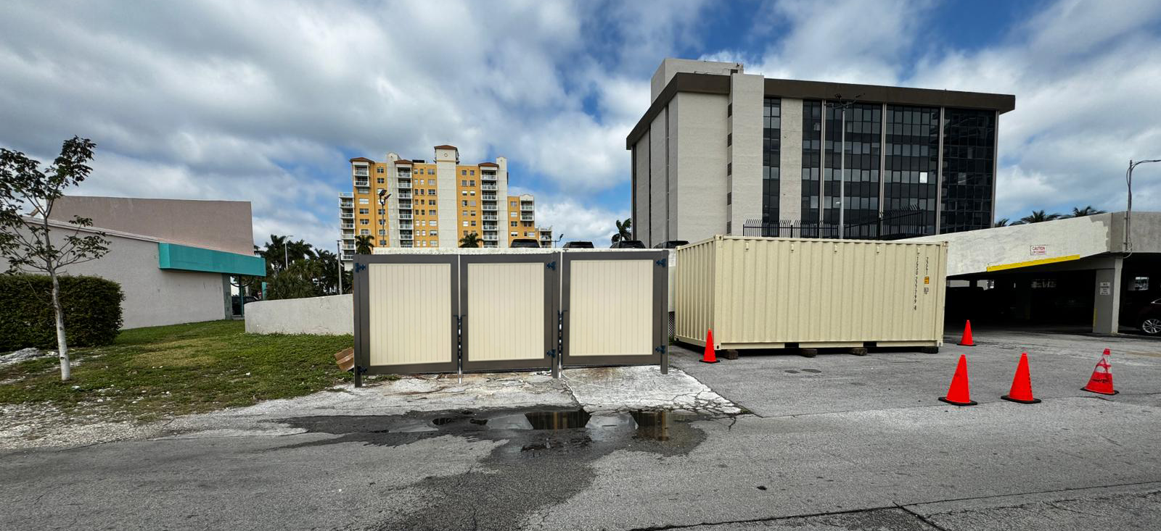
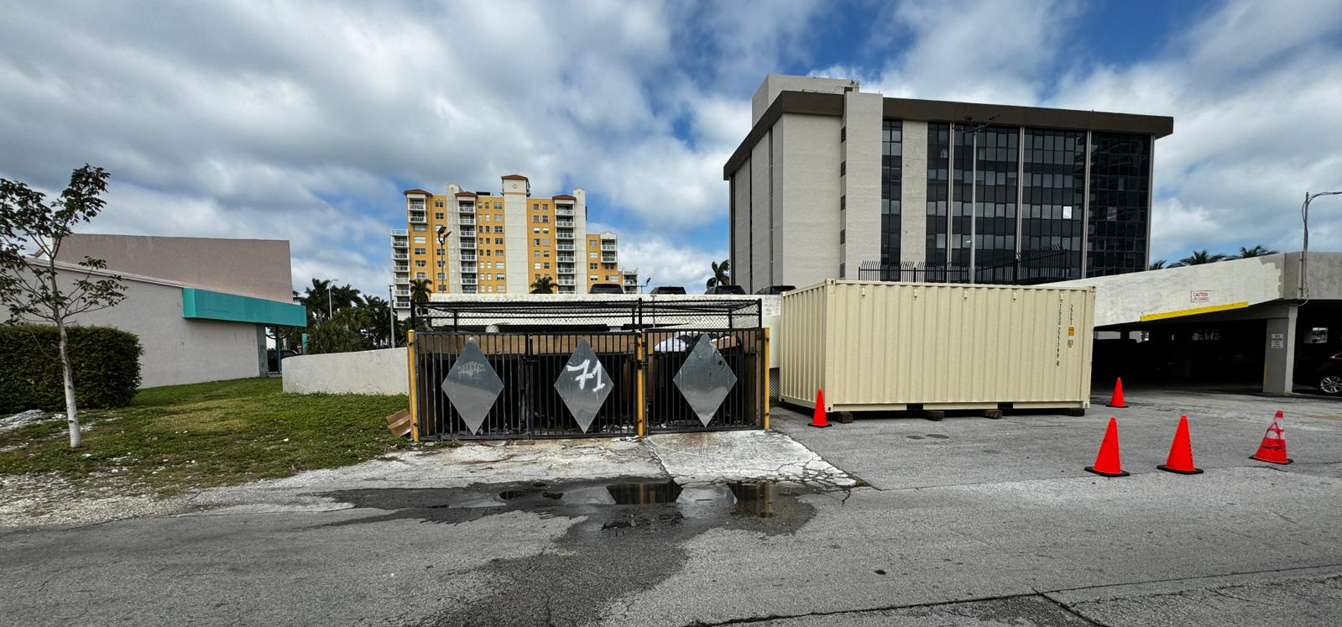
Short Term Improvements (cont.)
Dumpster Improvements
8 dumpsters serviced multiple times a week can be upgraded to create a unified aesthetic appearance
Adding upgraded dumpsters - improving the experience of walking along Pirates Alley

Slide 13
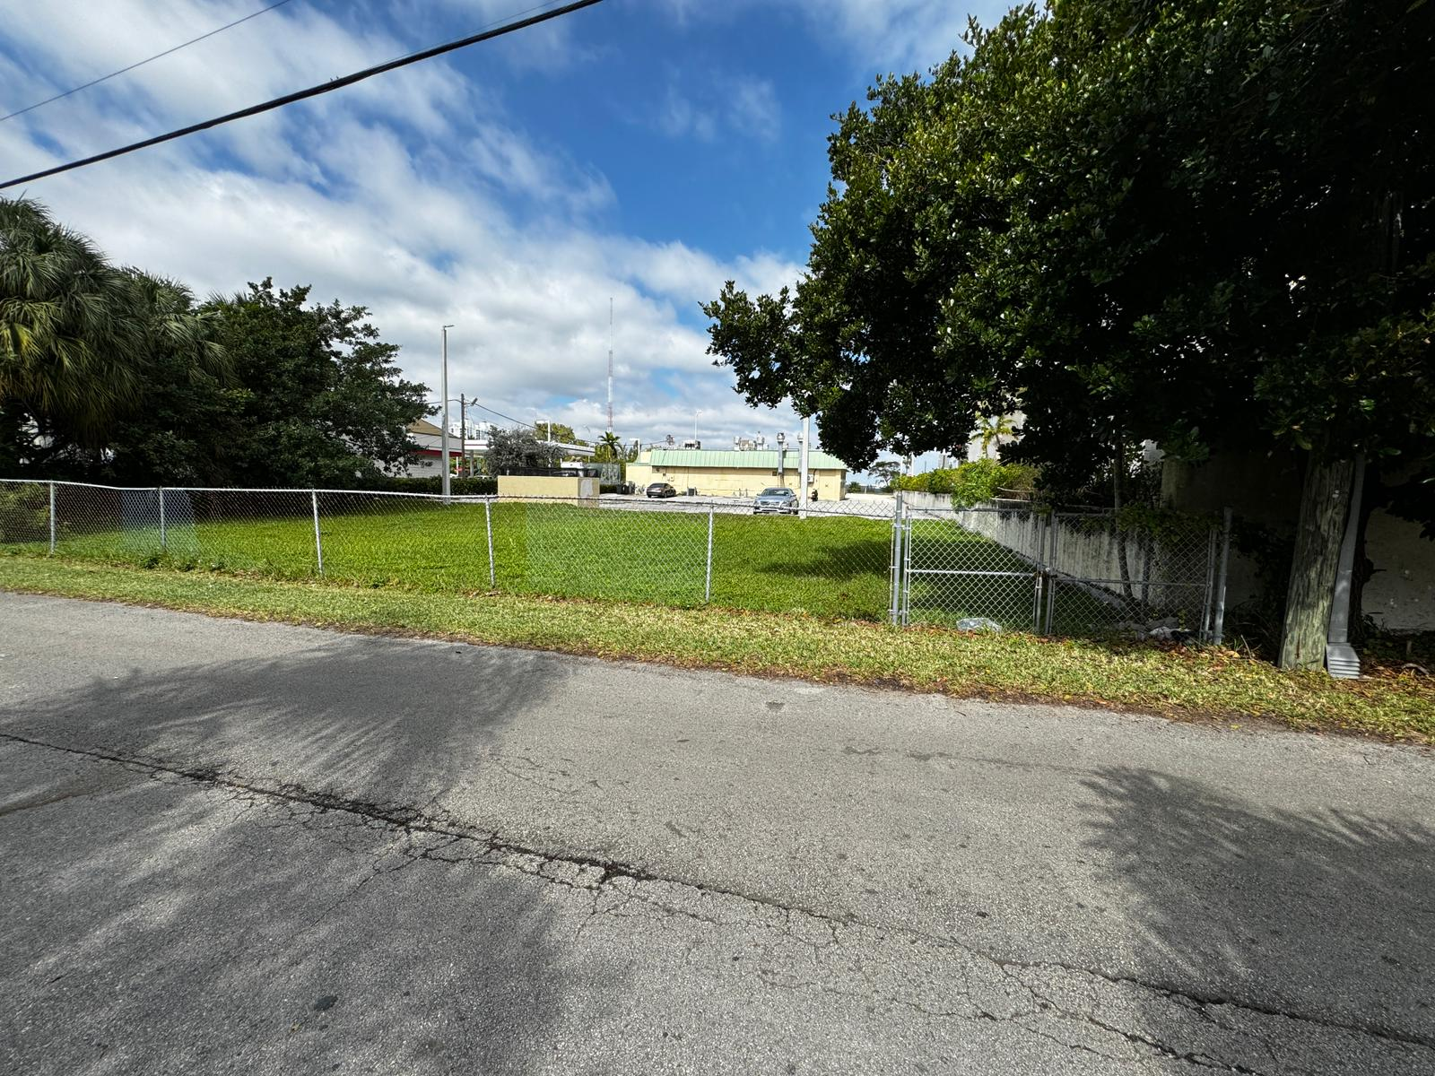
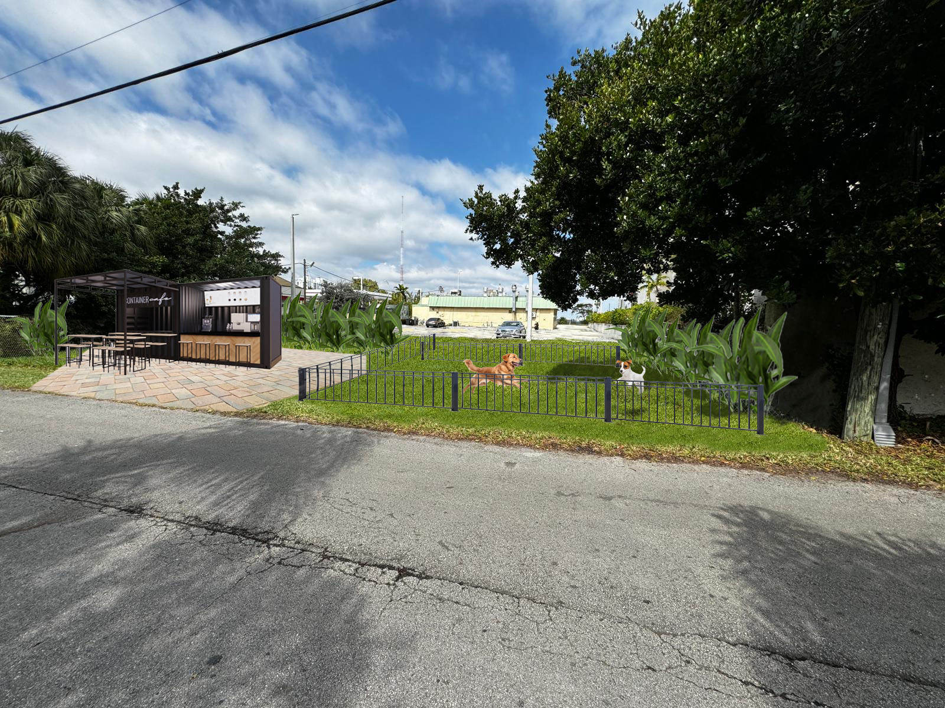
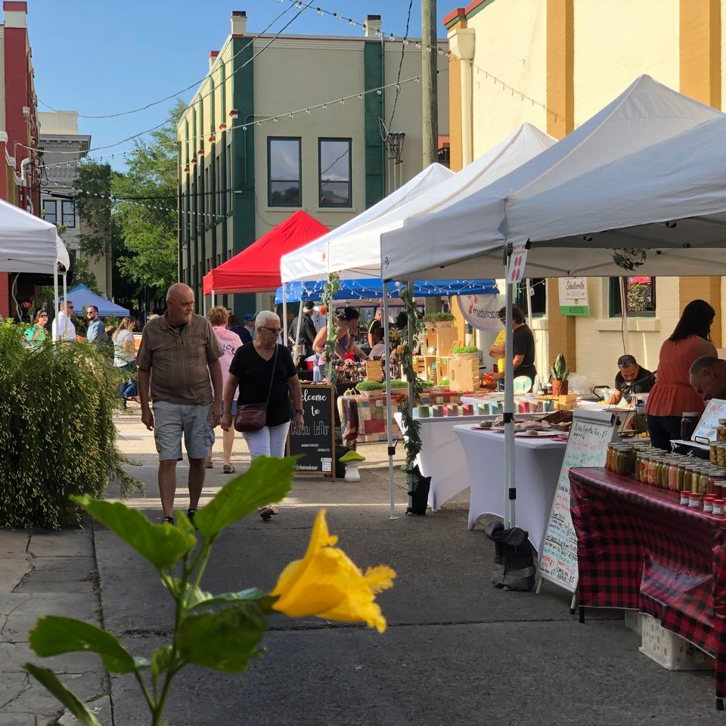
Short Term Improvements (cont.)
Activation
Temporary container coffee shop with a bike rack and community book drop/library would attract pedestrians to the Alley and would serve as proof of concept for the future commercial viability of Pirates Alley.
Activating the underutilized green space at 1500 79th Street Causeway as a park, temporary dog park, or pocket park with a temporary commercial container and seating space.
Activating the Alley for community events, such as farmers markets, on nights or weekends.

Slide 14
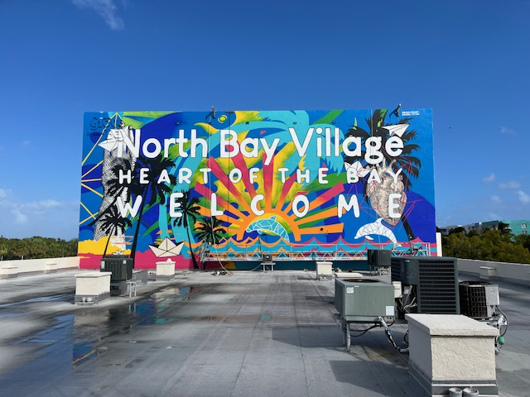
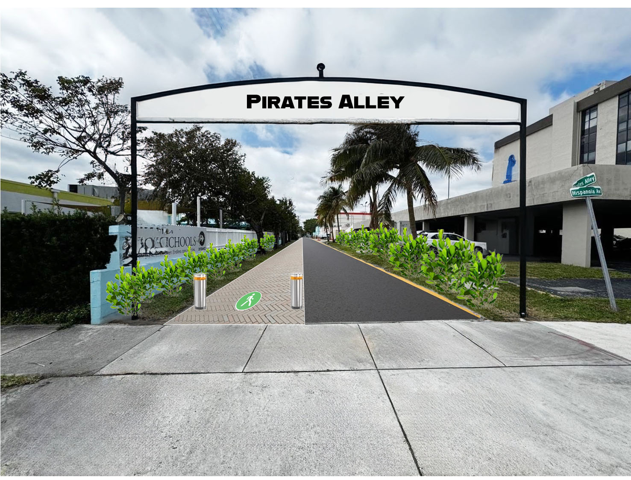
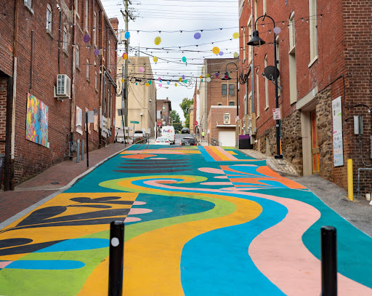
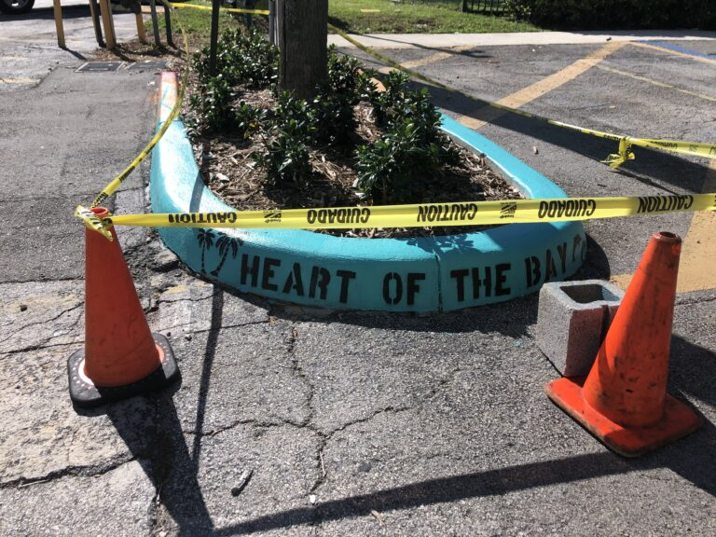
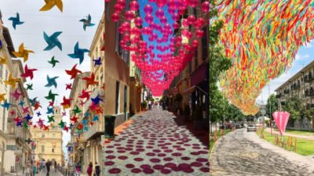
Short Term Improvements (cont.)
Public Art
“Heart of the Bay” Welcome Mural, Rigo Leon
Example of decorative pavement
Installation of public art will accomplish the Village’s goal of beautifying Pirates Alley, unifying the community, and continuing public art efforts the Village has made throughout the community.
Examples of hanging art installations
“Curb Appeal public art on Harbor Island

Slide 15
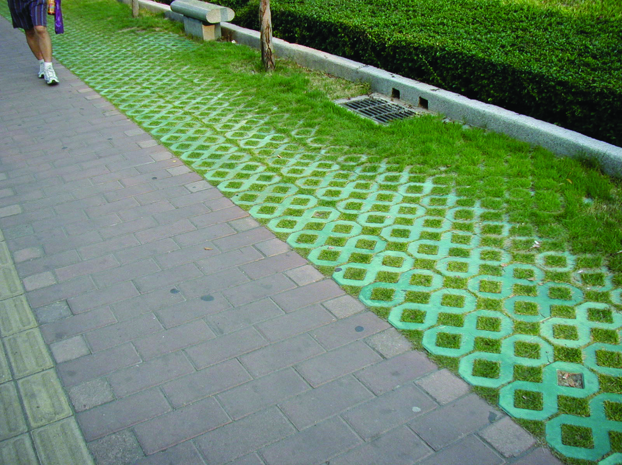
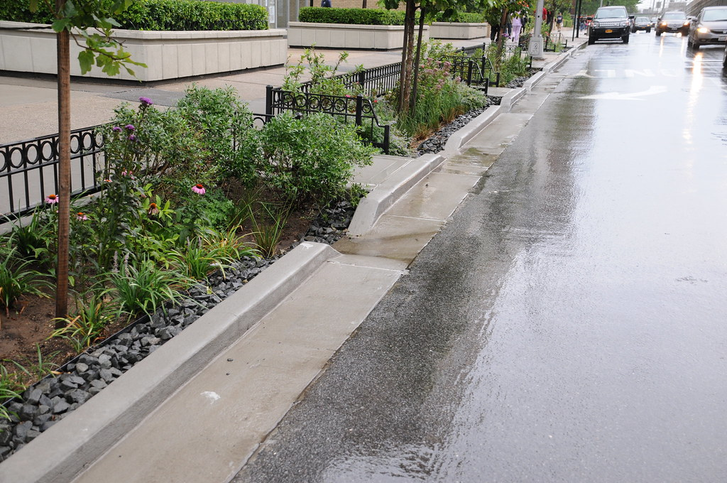
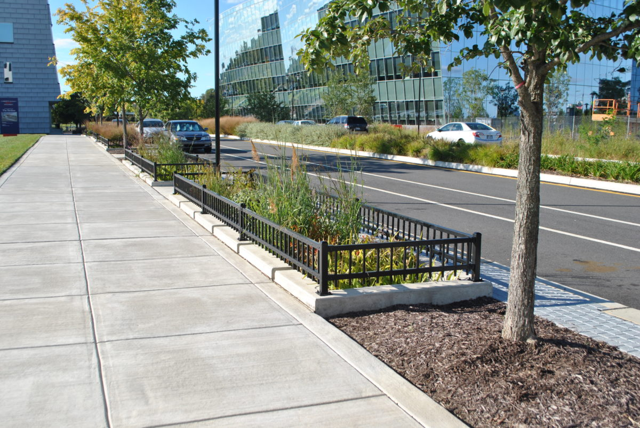
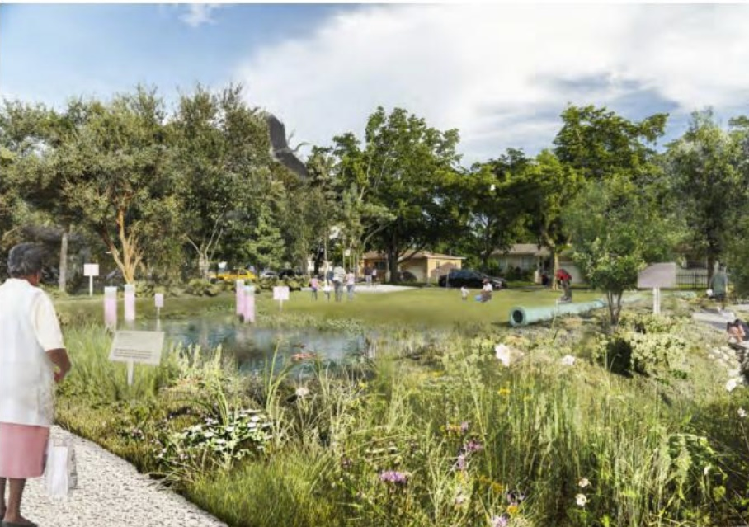
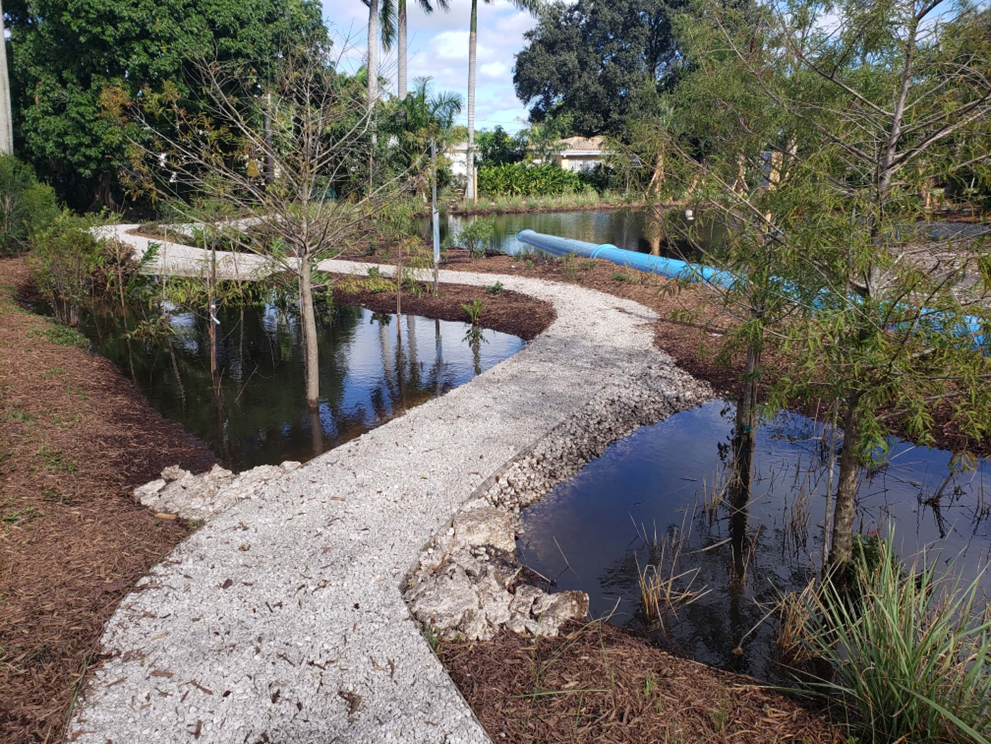
Short Term Improvements (cont.)
Resiliency
Permeable Pavers
Rain Garden, New York City
Planter Boxes, Navy Yard, Philadelphia, PA
Leverage green & resilient infrastructure elements: permeable pavers; rain gardens; planter boxes; stormwater retention basins that double as public parks.
These tools can help address the area’s drainage issues while also beautifying Pirates Alley.
Stormwater Park, City of North Miami

Slide 16
Long Term Improvements
Lighting Improvements
Public Park Fund
Special Assessment Districts can help fill the gap between public and private partners of future developments.
Special Assessment Districts can be petitioned for and voted on by homeowners in NBV or created by developers at the inception of a development project.
By engaging the community stakeholders early in the design process, NBV can ensure private property owners, business owners, residents, and pedestrian needs/concerns are addressed as part of the Pirates Alley redevelopment.
Special Assessment Districts
Created by homeowners or Developer
Covers cost of additional services through non-ad valorem assessment.
Public Art Fund
Impact Fee Fund for New Development
Pavement Improvements
Create pedestrian and bike lanes
Engage traffic engineers to create one-way road system
Clear road markings for vehicles, bikes, and pedestrians

Slide 17
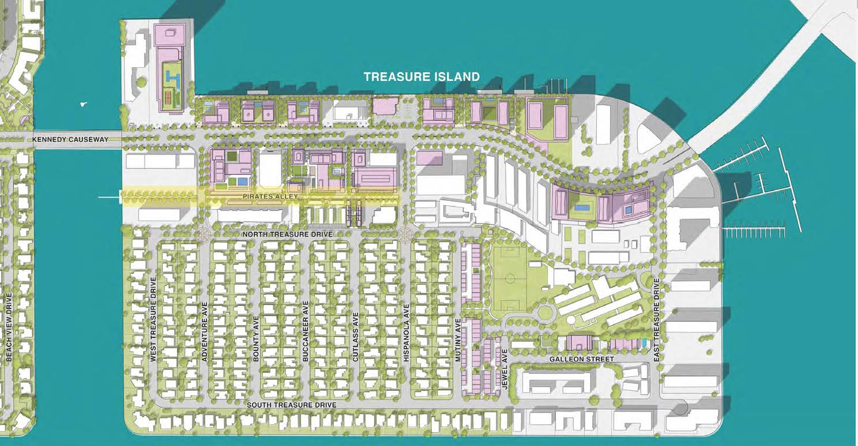
Long Term Improvements
As part of the NBV100 Master Plan for North Bay Village, the City could further their vision by adding a specific zoning overlay to the Pirates Alley.
Zoning overlays can be used to help fill the gap when traditional zoning does not account for specific local conditions or issues.
Density bonus for pedestrian oriented development
Increased building setbacks
Dedicated pedestrian and bike lanes
Design standards (landscaping, street design, etc).

Slide 18
Potential Challenges
KLA Traffic Flow Impact
FPL Power Lines
Commercial User Bottlenecks
Pedestrian Safety
Challenge: Disruption and alteration to current traffic patterns (drop off and pick up of children)
Solution: Conduct a traffic study and devise potential measures to mitigate bottlenecks
Challenge: Existing power lines prohibit the surface area of redevelopment detracting from the pedestrian experience and could constrain future commercial development
Solution: Work with FPL to assess cost and construction schedule for replacement of above-ground power lines with underground power lines
Challenge: Pedestrian walkway will likely affect the loading and unloading schedules of existing commercial users
Solution: In the short-term, dedicate times of day for loading and unloading, in the long-term, include alternative corridors in the zoning overlay
Challenge: Pedestrian walkway comes with precaution to ensure a safe user experience
Solution: Installing bollards will help to create a physical separation between pedestrians and vehicles, raised curbs, signage, and speedbumps could also be used

Slide 19
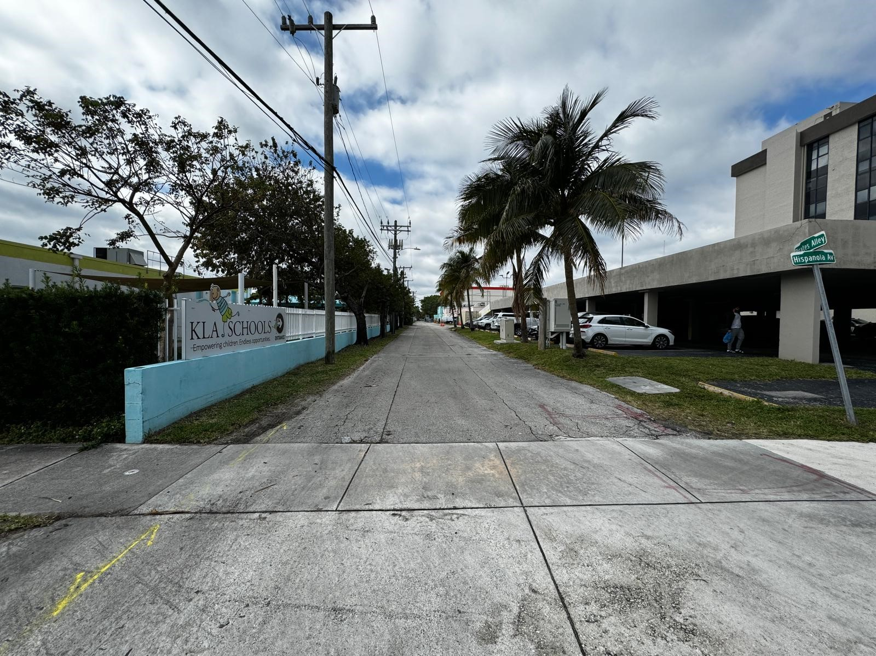
Thank you
Accelerating success.

Slide 20
Outstanding Items
North Bay Village – Pirate’s Alley
Meet with owner of 1500 79th Street Causeway to see if they are open to a public use of their parcel facing Pirate's Alley
Community Outreach – Facebook post in "North Bay Village Residents Speak" Group for opinions on the future of Pirate's Alley (add a Pirate's Alley email for people to reach out to)
Define challenges more clearly
Build out report more using this presentation as a guide/outline

Slide 21
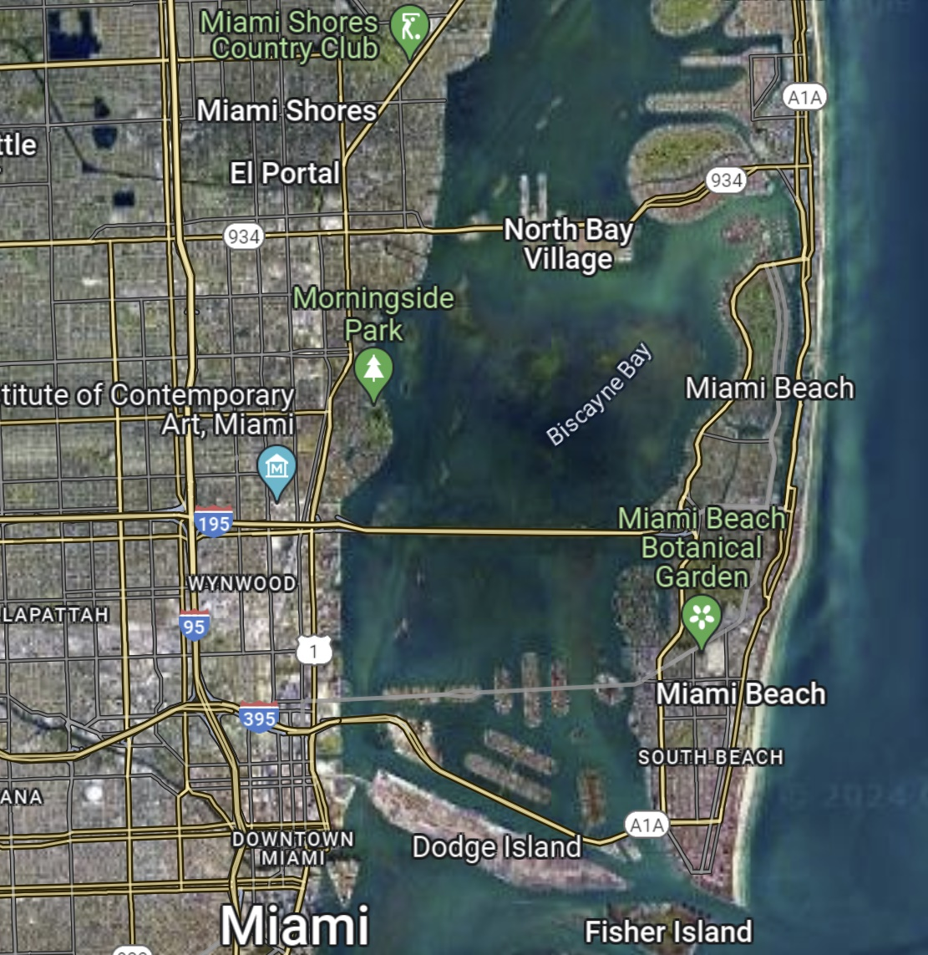
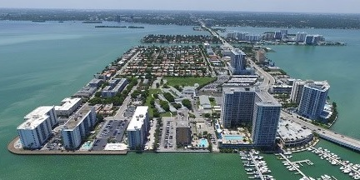
Background
North Bay Village
Multifamily (Apartment & Condo):
4,400+ existing units
250+ units under construction
2,600+ units proposed
Commercial:
285,000+ existing SF
280,000+ SF under construction
With the population steadily increasing, the thriving real estate market, and the potential for future expansion, the City recognizes the importance of enhancing walkability and fostering community engagement across the island.
The transformation of the back-end Pirate’s Alley into a pedestrian walkway aligns with these goals, providing residents and visitors alike with a safe and inviting space to enjoy the island’s scenic beauty and vibrant community atmosphere.

